Slide 1
Age estimation
Mark fesenko Noy boutboul

Slide 2
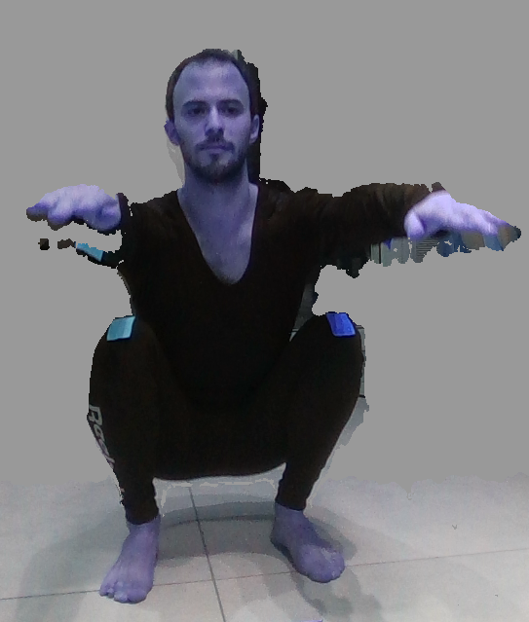
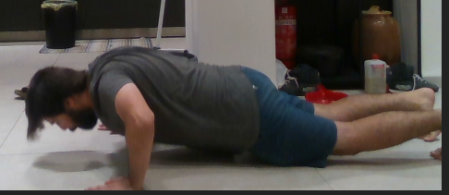
About
In this project we’ll be analyzing depth videos captured by intel real-sense of people in a variety of ages doing exercise, using image detection methods and pose estimation algorithms, to calculate relevant data for the Age Estimation research.

Slide 3
Objectives
Analayze accurate data from captured videos.

Slide 4
Environment & tools
Intel real-sense camera & SDK.
Python \ CPP programming language.
OpenCV python library for image processing.
Pose Estimation Algorithms such as OpenPose, AlphaPose, Cubemos, etc.

Slide 5
Schedule
Weeks 1-3: installing environment, tools, algorithms. and working on a demo POC. In addition, finalizing the project specification with Mayaan.
Week 4-6: Analyzing and producing the data that is required in the specification, comparing it with the expected output?, middle presentation?
Week 7-8: Analyzing the output data with Mayaan and tuning it up to be exact & optional – adding new specifications.
Week 9-12: adding GUI.
Week 13-end: finishing all ends, end presentation.

Slide 6
progress

